Slide 1
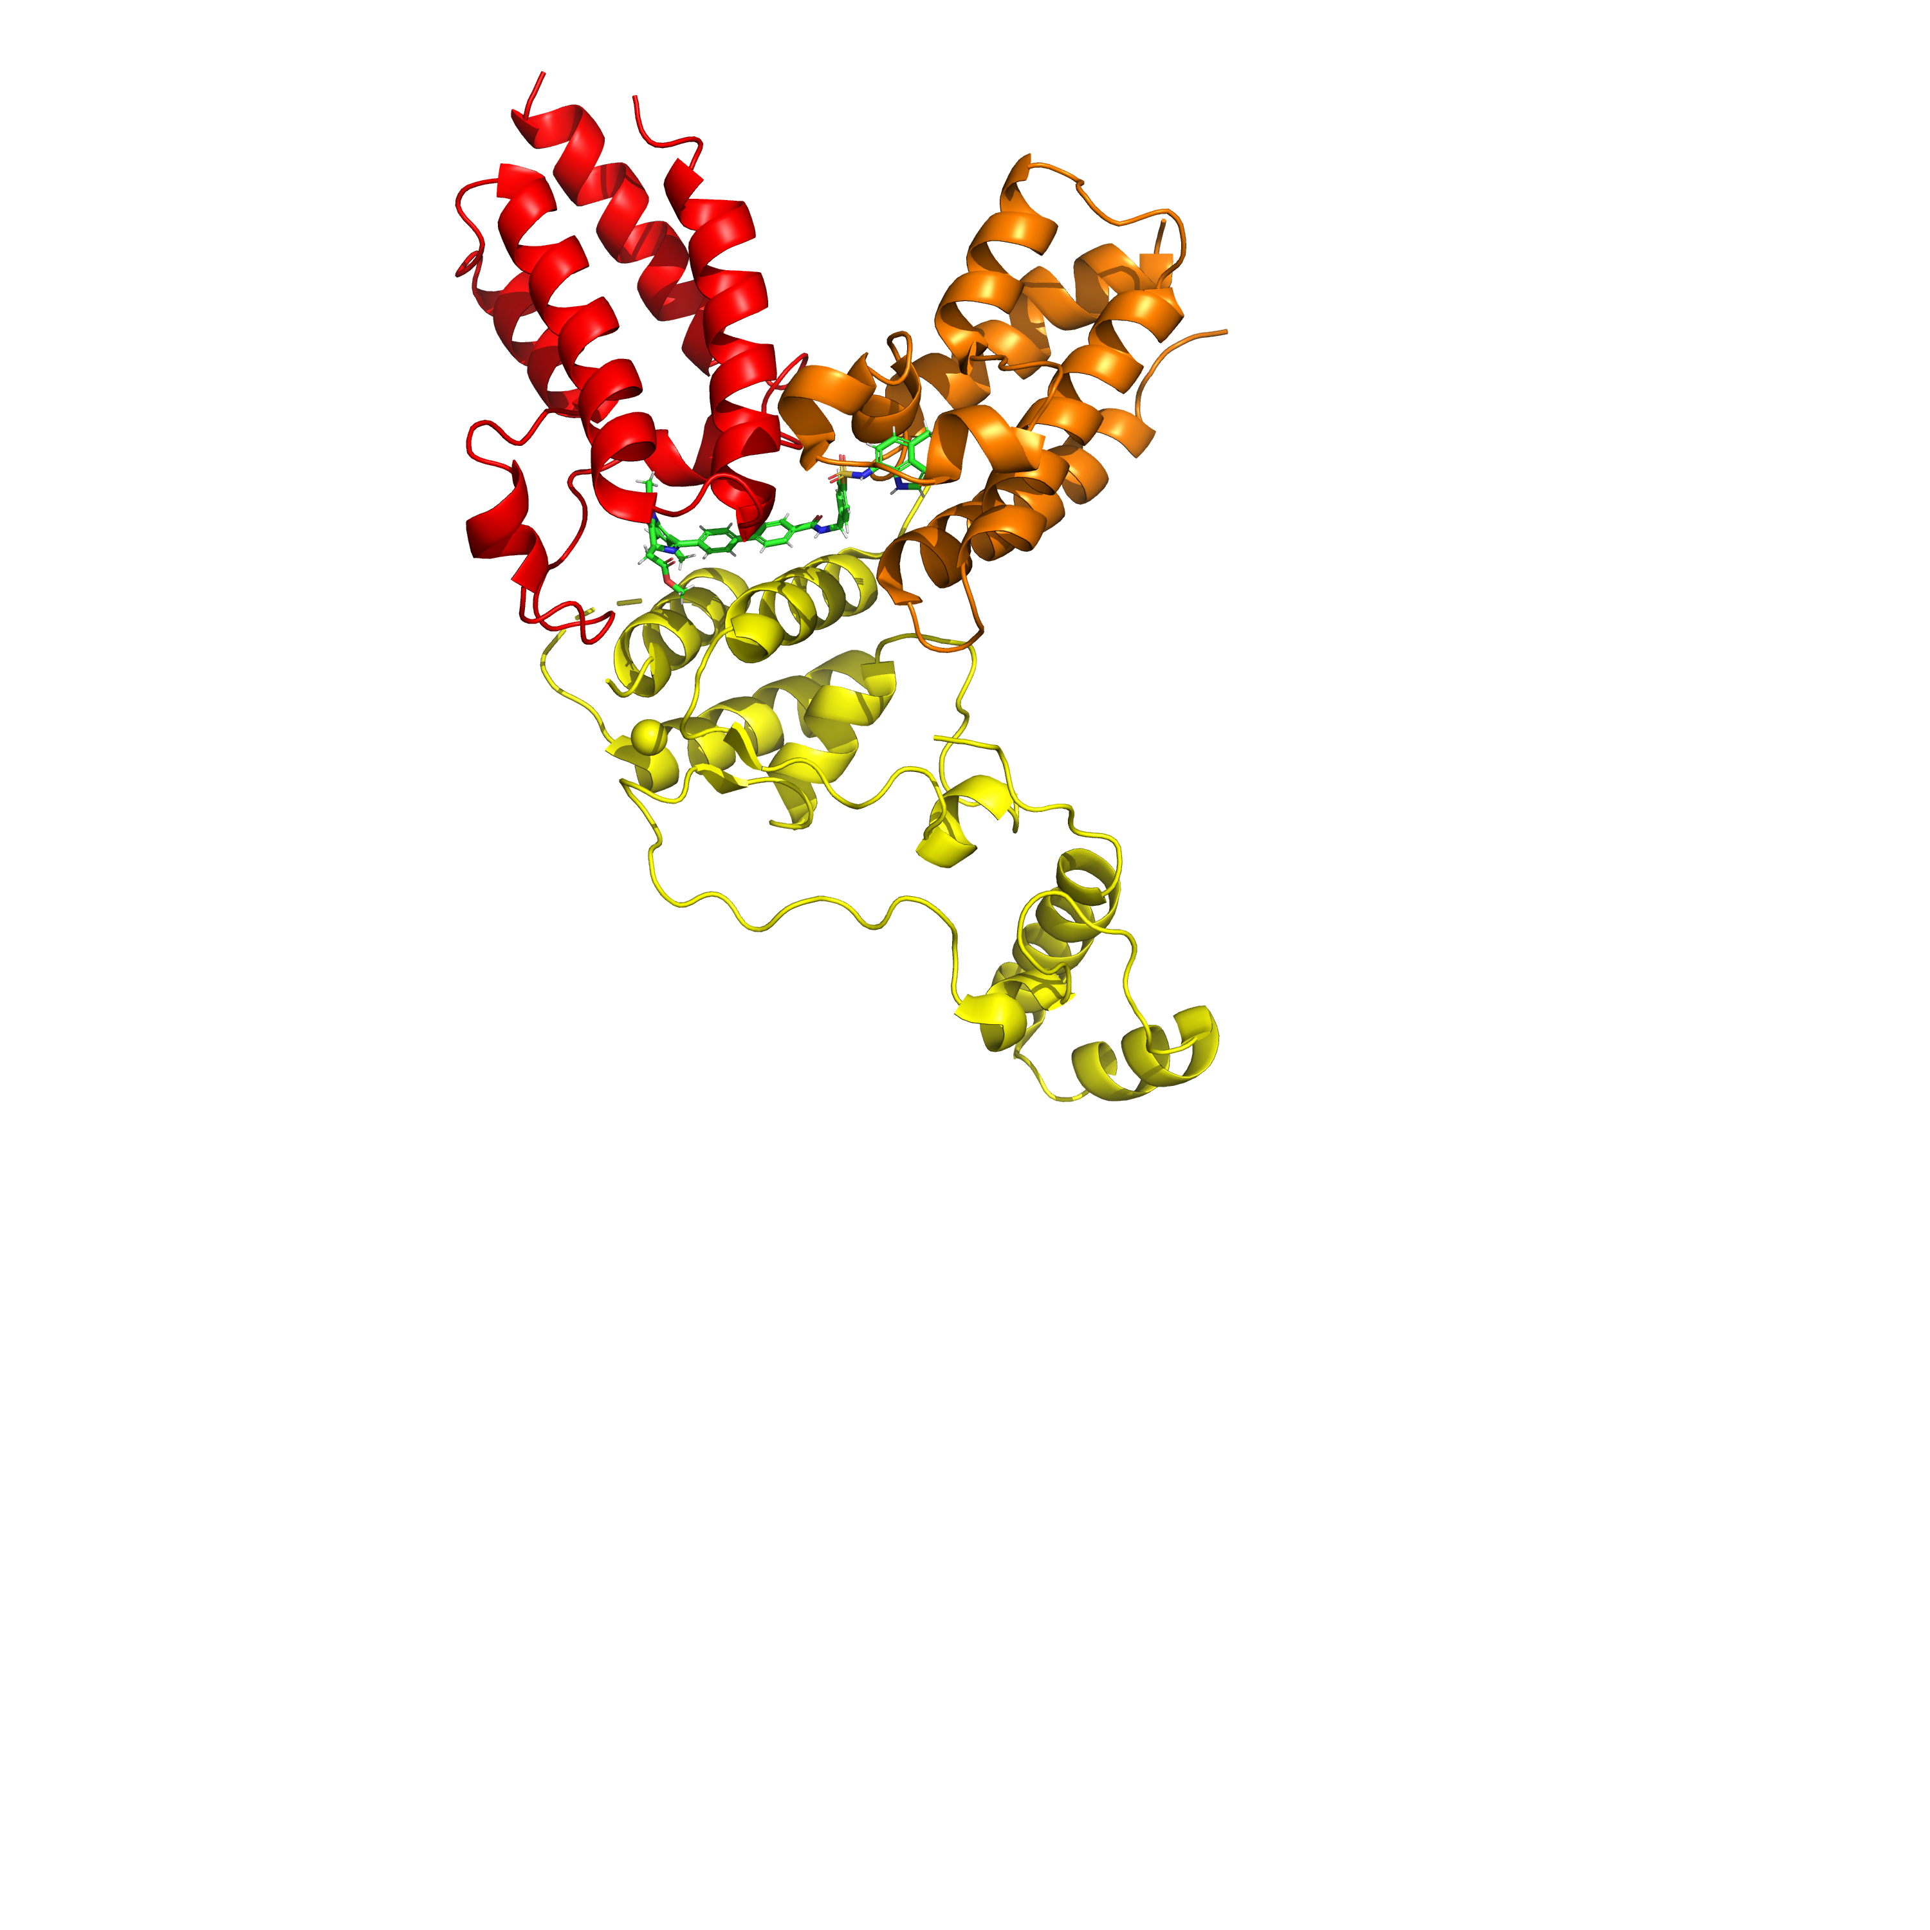
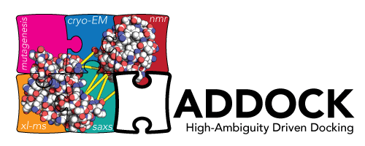


Absolute Bindng Free Energy Calculations of Bivalent Molecular Glues Fangzhou Yan Supervisors: Julien Michel, Benedict Tan

Slide 2
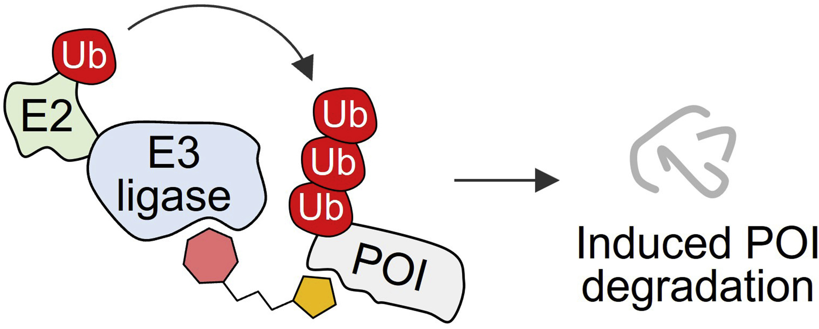
Targeted Protein Degradation
Kramer, L. T., & Zhang, X. (2022). Current Research in Chemical Biology, 2, 100020.

Slide 3
Targeted Protein Degradation
Ubiquitination
Kramer, L. T., & Zhang, X. (2022). Current Research in Chemical Biology, 2, 100020.

Slide 4
Targeted Protein Degradation
Ubiquitination
Small molecules induce proximity of E3 and POI:
Kramer, L. T., & Zhang, X. (2022). Current Research in Chemical Biology, 2, 100020.

Slide 5
Targeted Protein Degradation
Ubiquitination
Small molecules induce proximity of E3 and POI:
e.g. bivalent molecular glues
Kramer, L. T., & Zhang, X. (2022). Current Research in Chemical Biology, 2, 100020.

Slide 6
Targeted Protein Degradation
Ubiquitination
potential in drug design !
Small molecules induce proximity of E3 and POI:
e.g. bivalent molecular glues
Kramer, L. T., & Zhang, X. (2022). Current Research in Chemical Biology, 2, 100020.

Slide 7
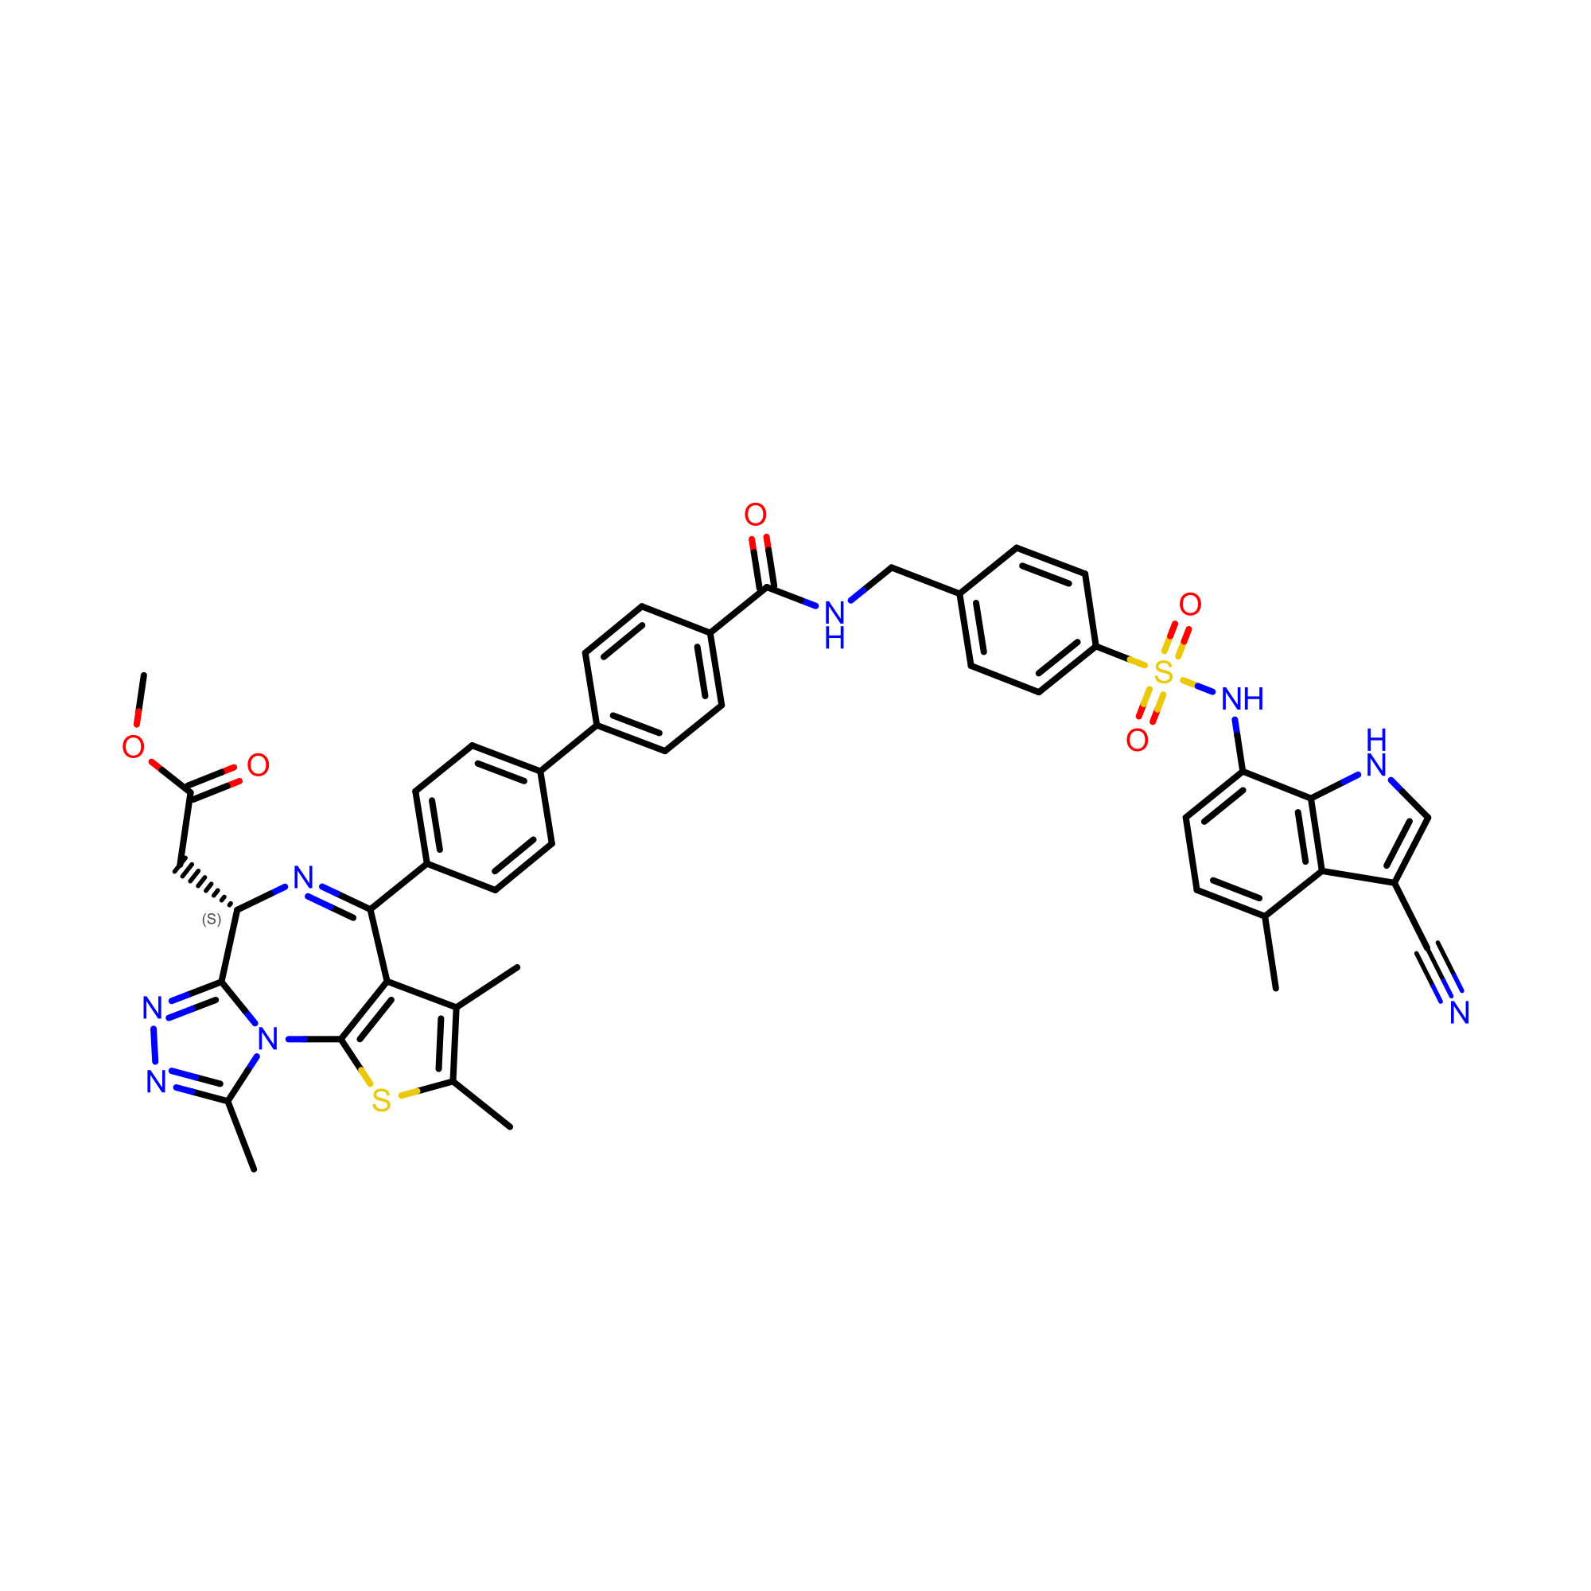
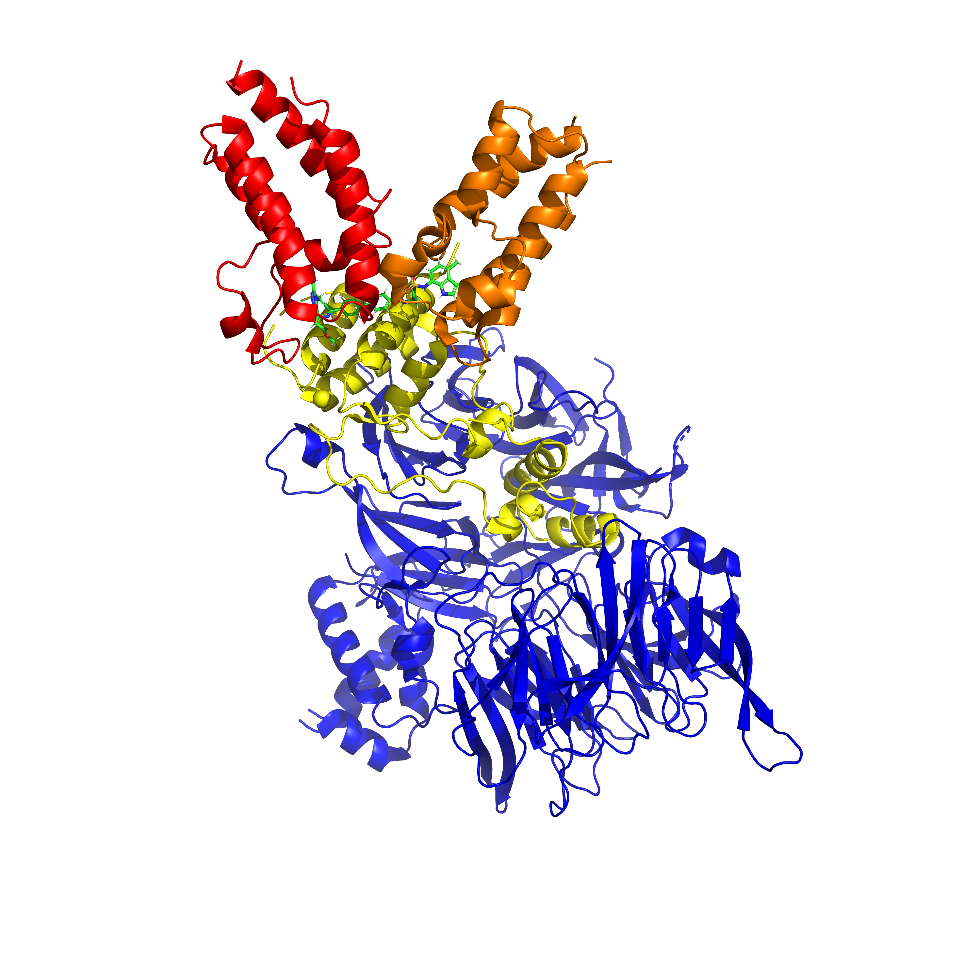
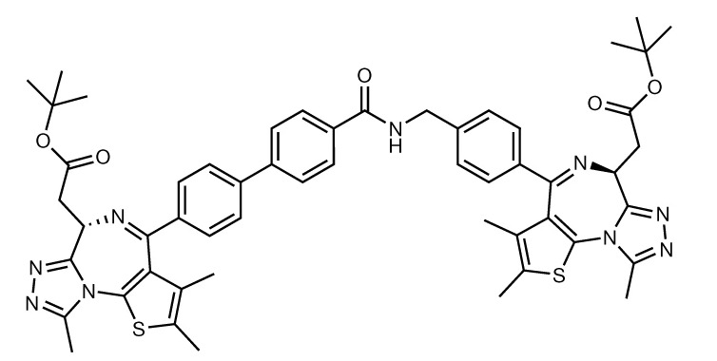
The Ternary System
(1) BRD4 (target bromodomain protein)
(3) IBG1: Molecular Glue
BD2
BD1
JQ1
E7820
DCAF16
receptor
IBG3: a more potent modification
JQ1
JQ1’
(2) E3 ligase complex
DDB1 adaptor
JQ1 has a higher affinity to bromodomains
Hsia, O., Hinterndorfer, M., Cowan, A.D. et al. Nature 627, 204–211 (2024).

Slide 8
Goals of the Project
Find an optimal computational method that can calculate the absolute binding free energy (ABFE) of the molecular glues.
Compare the precisons of different restraints.
Show quantitatively the binding-affinity trend (e.g. IBG3 > IBG1).
focus on the interface

Slide 9
Molecular Dynamic Simulations
At time t
given initial:
-position
-velocity
-force
v
F

Slide 10
Molecular Dynamic Simulations
At time t + Δt:
v
F

Slide 11
Molecular Dynamic Simulations
At time t + Δt:

Slide 12
Molecular Dynamic Simulations
At time t + Δt:

Slide 13
Molecular Dynamic Simulations
At time t + Δt:
new:
-position
-velocity
-force
...
v’
F’

Slide 14
Molecular Dynamic Simulations
Apply to all molecules:

Slide 15
Molecular Dynamic Simulations
Apply to all molecules:
-use forcefields to calculate forces:
stretching
bending
non-bonded
torsion
Wang, J., Wolf, R. M., Caldwell, J. W., Kollman, P. A., & Case, D. A. (2004). Journal of Computational Chemistry, 25(9), 1157–1174.

Slide 16

Molecular Dynamic Simulations
*solvent molecules were hidden

Slide 17
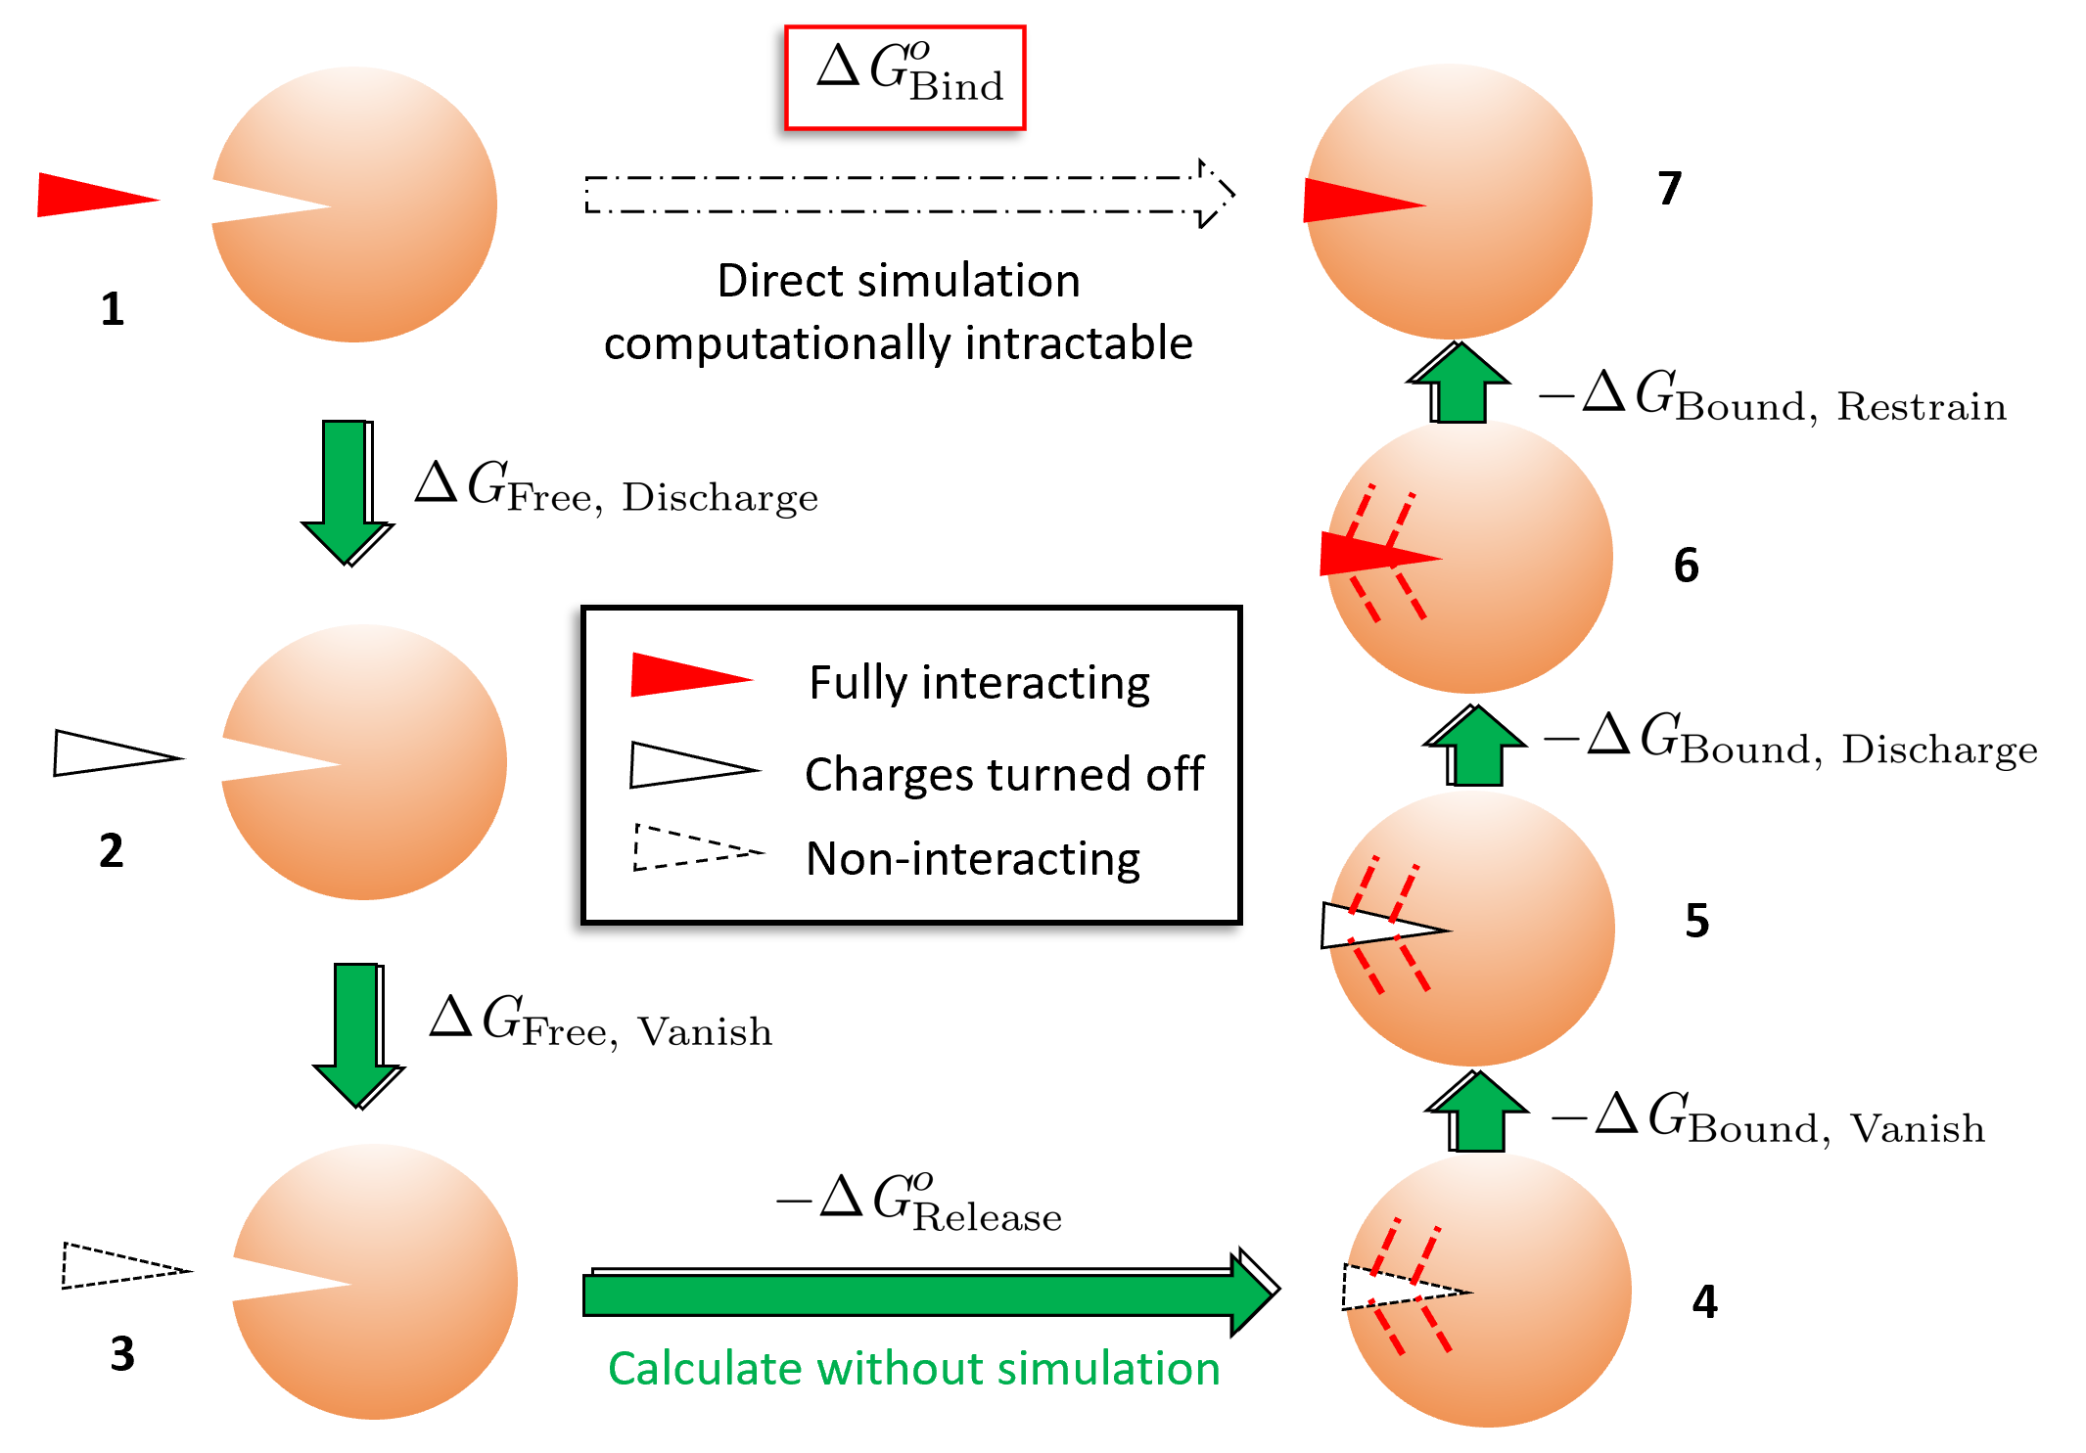
How to Calculate Free Energy Changes

Slide 18
How to Calculate Free Energy Changes
Rare direct binding/unbinding.
Actual vs simulation timescale : s vs ns

Slide 19
How to Calculate Free Energy Changes
Rare direct binding/unbinding.
Actual vs simulation timescale : s vs ns
Thermodynamic cycle of “non-physical” states.
Simulate each stage separately by turning off corresponding interactions.

Slide 20
How to Calculate Free Energy Changes
bound-leg
Rare direct binding/unbinding.
Actual vs simulation timescale : s vs ns
Thermodynamic cycle of “non-physical” states.
Simulate each stage separately by turning off corresponding interactions.

Slide 21
How to Calculate Free Energy Changes
free-leg
Rare direct binding/unbinding.
Actual vs simulation timescale : s vs ns .
Thermodynamic cycle of “non-physical” states.
Simulate each stage separately by turning off corresponding interactions.

Slide 22
How to Calculate Free Energy Changes
Rare direct binding/unbinding.
Actual vs simulation timescale : s vs ns
Thermodynamic cycle of “non-physical” states.
Simulate each stage separately by turning off corresponding interactions.
Restraints to fix the non-interacting ligand inside the binding pocket.
Correction for the loss of entropy.

Slide 23
How to Calculate Free Energy Changes
Rare direct binding/unbinding.
Actual vs simulation timescale : s vs ns
Thermodynamic cycle of “non-physical” states.
Simulate each stage separately by turning off corresponding interactions.
Restraints to fix the non-interacting ligand inside the binding pocket.
Correction for the loss of entropy.

Slide 24
How to Calculate Free Energy Changes
Rare direct binding/unbinding.
Actual vs simulation timescale : s vs ns
Thermodynamic cycle of “non-physical” states.
Simulate each stage separately by turning off corresponding interactions.
Restraints to fix the non-interacting ligand inside the binding pocket.
Correction for the loss of entropy.
Choice of restraints is important.

Slide 25
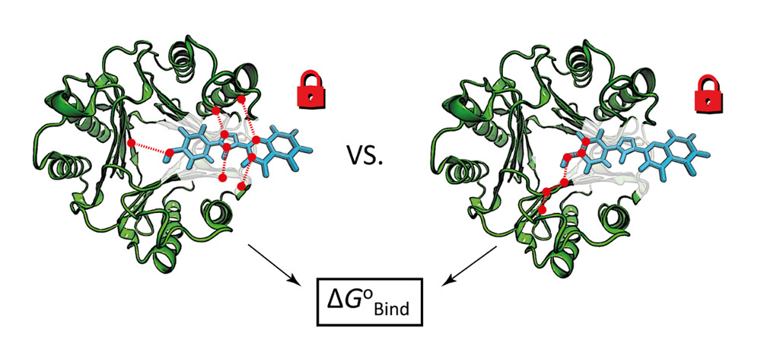
Comparisons of Two Types of Restraints
Multiple Distance Restraints (MDR) | Boresch Restraints (BR)
Multiple distance restraints between atom pairs. Multiple anchor points on protein and ligand. Ligand restrained to a greater extent. | Six external degrees of freedom (1 distance, 2 angles, 3 dihedrals) 3 atoms of protein and 3 atoms of ligand. Stability sensitive to the chioce of anchor point.
Extra simulations to get ΔG_{Release} | Direct calculation of ΔG_{Release}
MDR
BR (more commonly used)
J. Chem. Theory Comput. 2023, 19, 12, 3686–3704

Slide 26
Comparisons of Two Types of Restraints
1 ns simulations for 5 replicas (repeats).
Assumption: both will give similar overall energy, but MDR will be more precise.
Stage | Boresch Energy [kcal/mol] | Multiple Distance Energy [kcal/mol]
Bound-discharge | 162.00 ± 0.75 | 162.02 ± 1.18
Bound-vanish | 27.12 ± 1.75 | 32.15 ± 3.77
Bound-restrain | 1.27 ± 0.10 | 0.27 ± 0.26
Restrain correction | -9.44 (no simulation) | -20.15 ± 0.50
Final Free Energy | -41.77 ± 3.07 | -34.90 ± 3.73

Slide 27
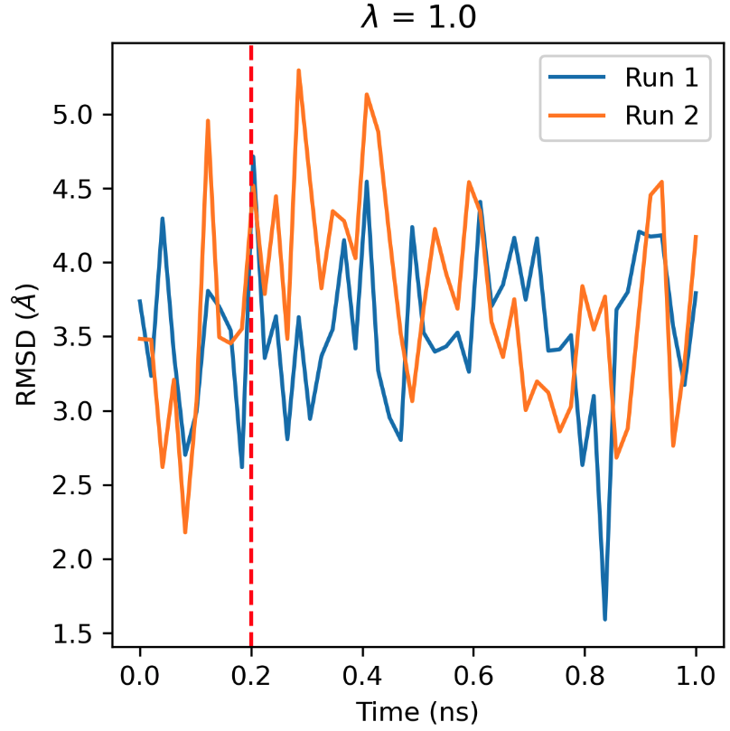
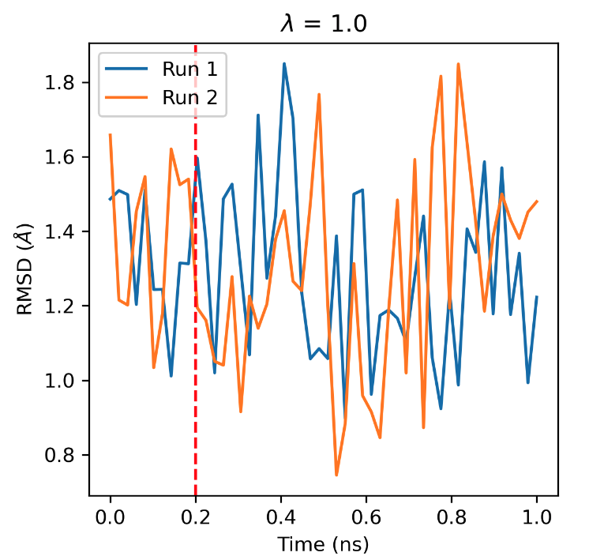
Comparisons of Two Types of Restraints
1 ns simulations for 5 replicas (repeats).
Assumption: both will give similar overall energy, but MDR will be more precise.
Ligand more fixed in place with MDR.
RMSD (root-mean-square deviation) of bound-vanish (λ= 1) of two runs:
protein-ligand interactions turned off
Boresch
Multiple Distance

Slide 28
Comparisons of Two Types of Restraints
1 ns simulations for 5 replicas (repeats).
Assumption: both will give similar overall energy, but MDR will be more precise.
Ligand more fixed in place with MDR.
Conclusion: for this molecular glue system, MDR can be a potential replacement of BR, and will produce free energies in similar precisions.

Slide 29
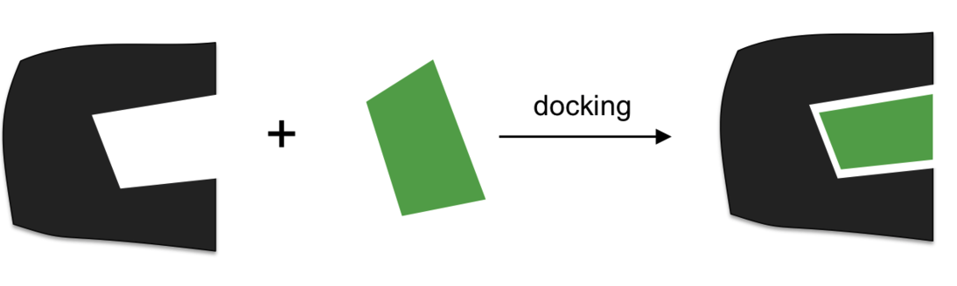
Find the Binding Pose of IBG3
Problem: don’t have an existing crystal structure of IBG3.
Solution: use docking to find the binding pose.
Molecular Docking: predicts the binding mode with ligand and protein as separate inputs.

Slide 30
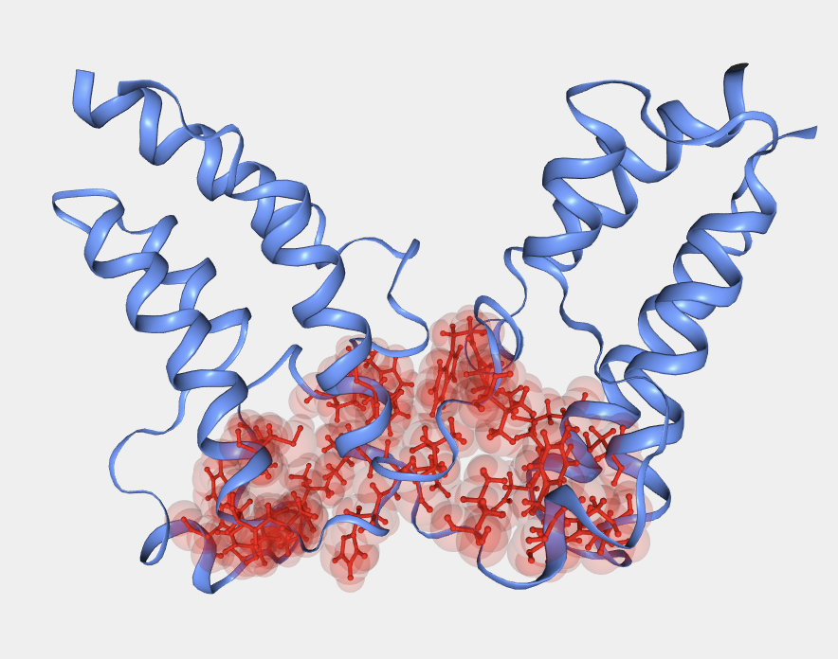
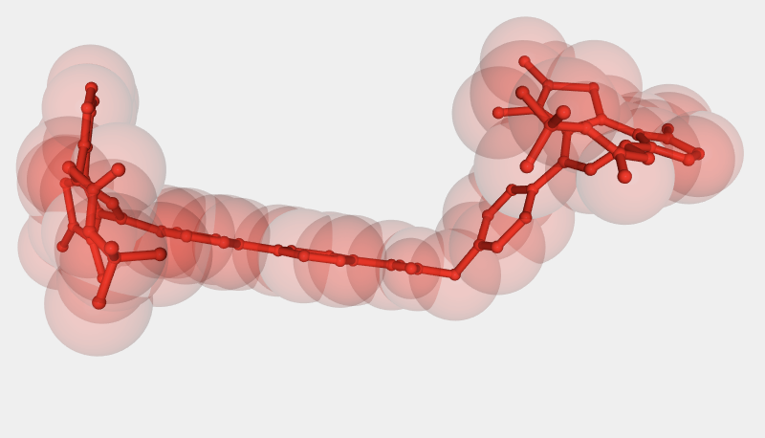
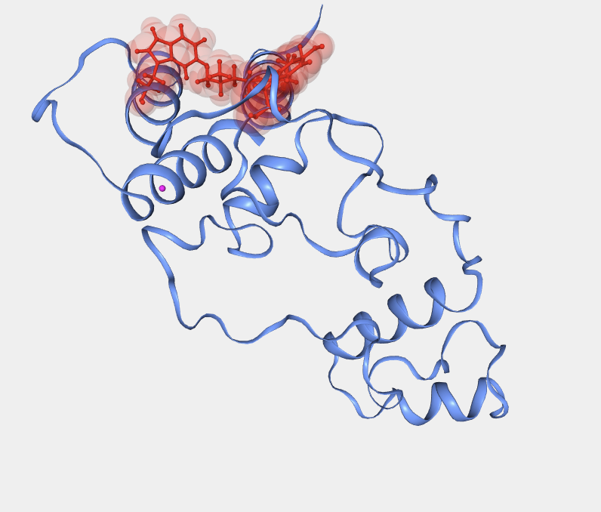
Haddock 2.4
Use Haddock 2.4 webserver.
High-Ambiguity Driven DOCKing.
Supply the docking protocol with interface ‘active’ residues.
These residues are treated as having a high chance of forming favourable interactions.
Distance restraints to fix the ligand inside the binding pocket and bring proteins together.
https://rascar.science.uu.nl/haddock2.4/

Slide 31
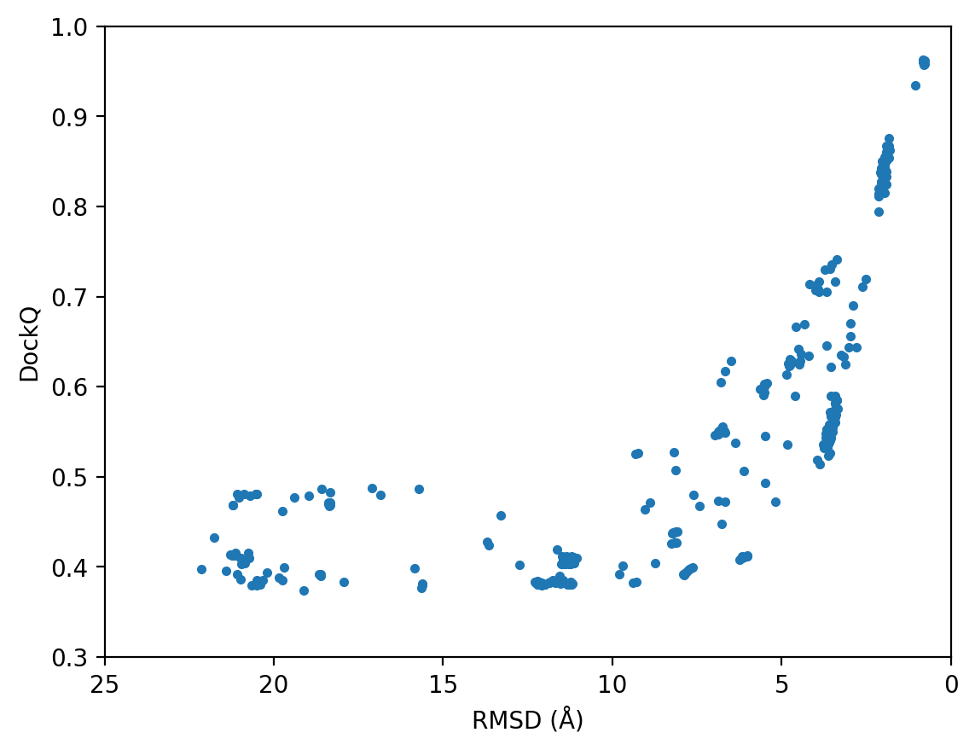
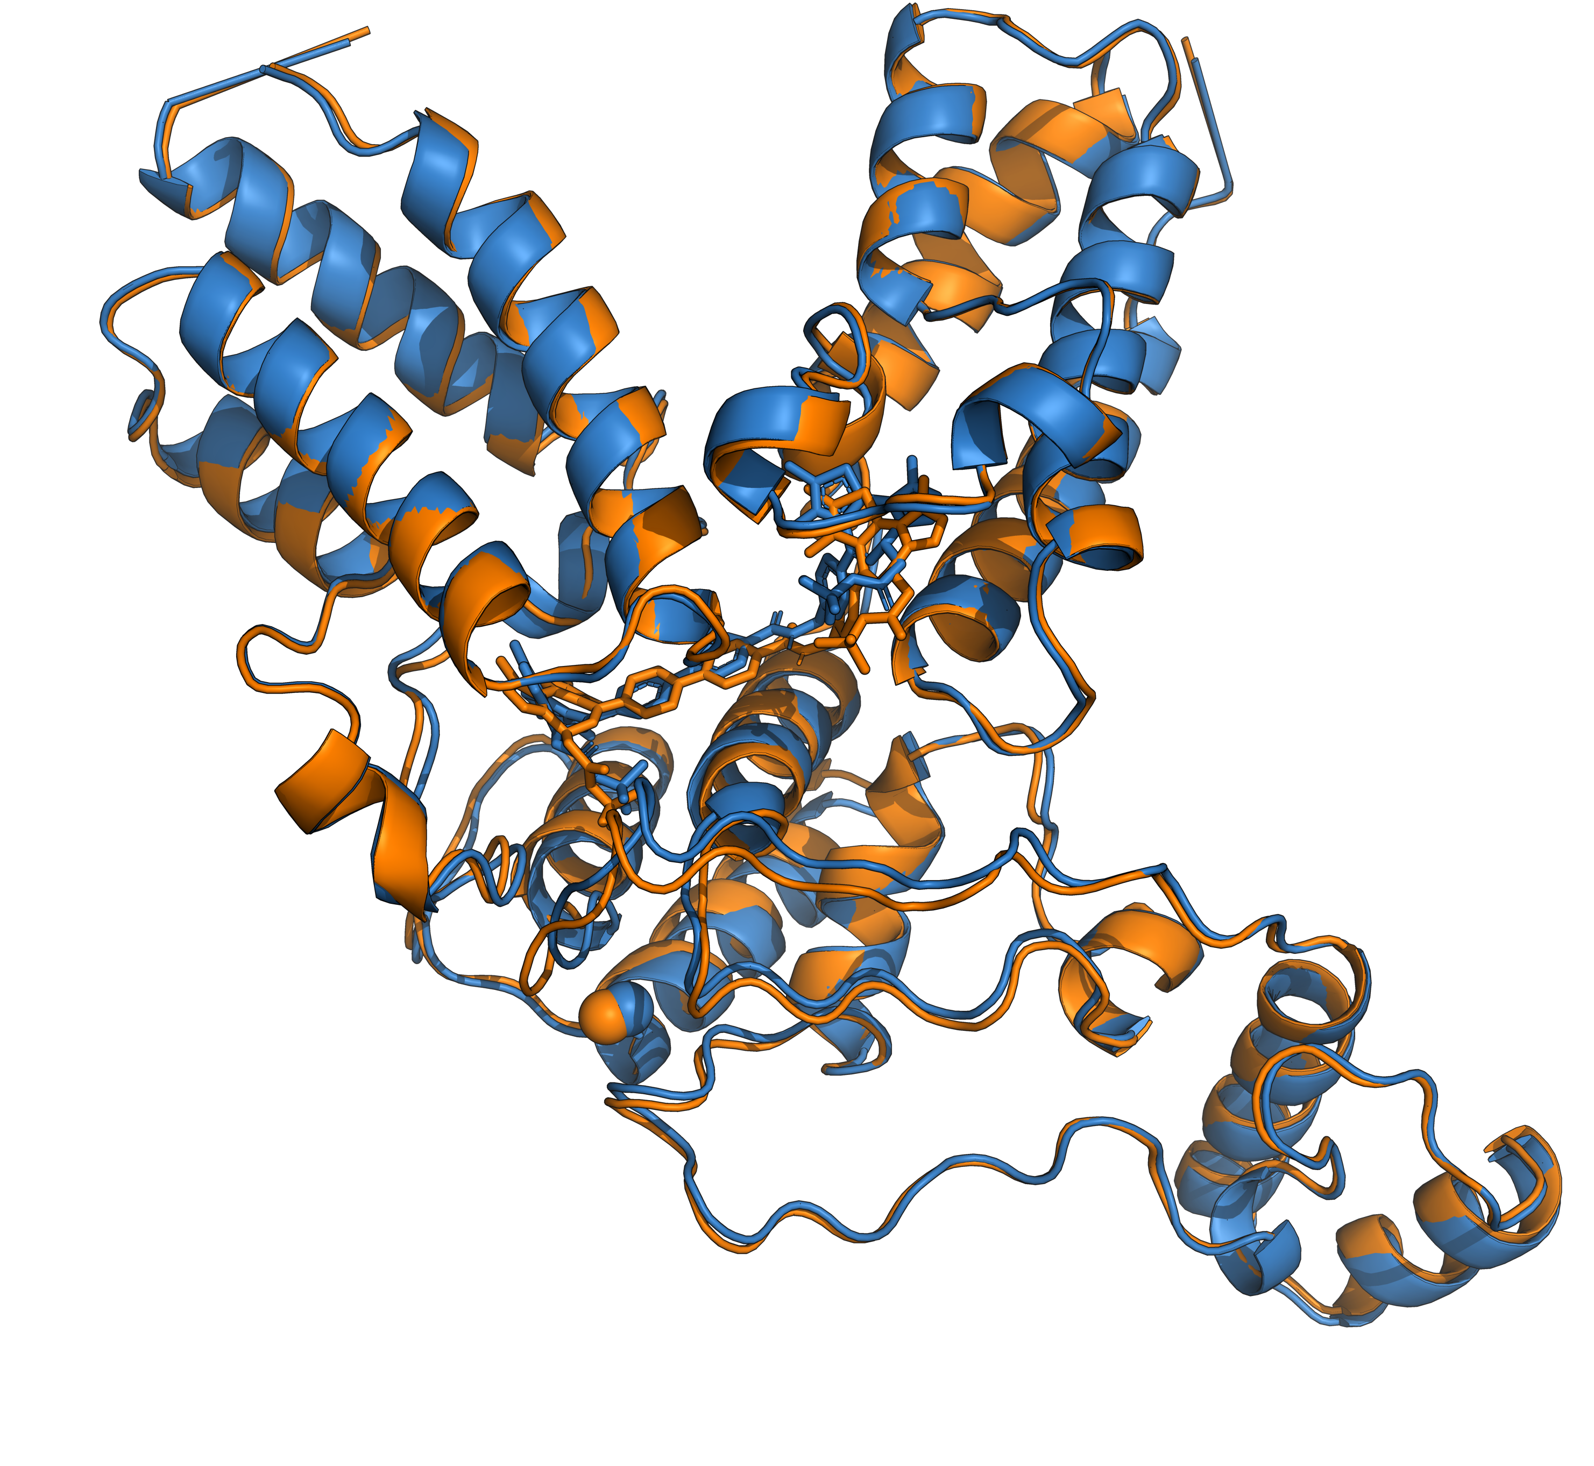
Result Analysis: DockQ
Made a template based on IBG1 crsytal structure.
DockQ: measures how well the haddock structures agree with the template structure (0 = bad, 1 = perfect).
RMSD: measures the average distance between the atoms of two molecular structures (smaller = better).
Free energy (IBG3 vs IBG1):
-43.15 ±3.24 kcal/mol vs -34.90 ±3.72 kcal/mol
Best Structure
Template

Slide 32
Future Work
Longer simulations for better convergence.
A protein-protein free energy protocol for mutant BRD3.
MD refinement for IBG3 system.
May test different correction scheme for MDR (Intramolecular Rigidification).
Use the ABFE protocol to screen a series of potential molecular glues.

Slide 33
Thanks for listening
Acknowledgments:
João Morado, Roy (Haolin) Du and Audrius Kalpokas in Michel Group.
Thanks for the hardwork of the workstations: ishikawa and biollante.

Slide 34
S1: why similar precisions for two restraints
Better overlaps between sampled states will give better precisions.
For MDR, the sampled configurations overlaped more while restraints are turned on, but larger difference between restrained and unrestrained states.

Slide 35
S2: lit values for IBG1 and IBG3
IBG1 vs. IBG3
EC₅₀: 44 nM vs 32 nM (from TR-FRET).
DC₅₀: 0.15 nM vs 6.7 pM (from FACS).
No data for the direct binding energy.
Stronger binding -> higher potency.
Hsia, O., Hinterndorfer, M., Cowan, A.D. et al. Nature 627, 204–211 (2024).

Slide 36
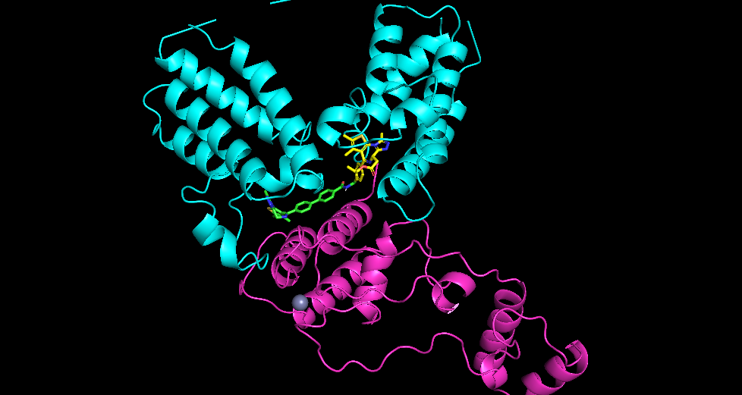
S3: IBG3 Template
IBG1’s JQ1 + a known BD1 + JQ1’ crystal structure.

